Slide 1
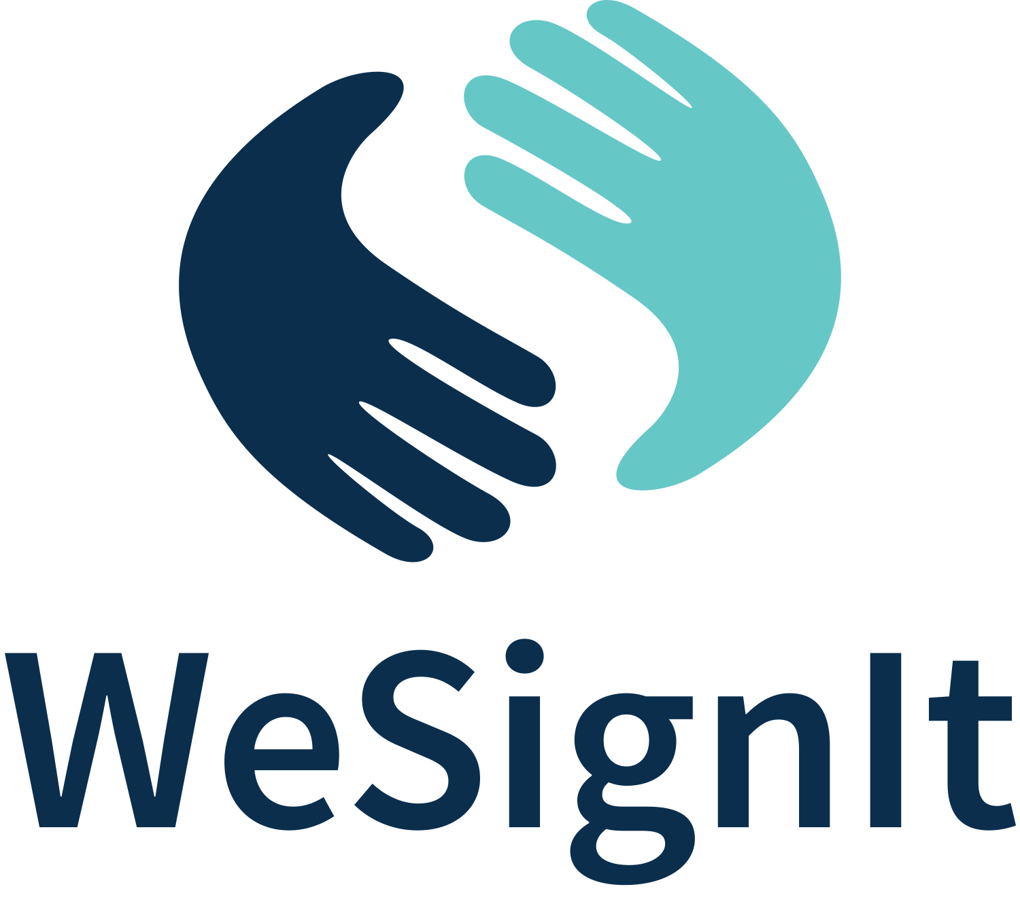

WeSignIt
Bridging the Communication Gap
Nick de la Hunt – Director of Wigital
Date: 4 August 2025

Slide 2
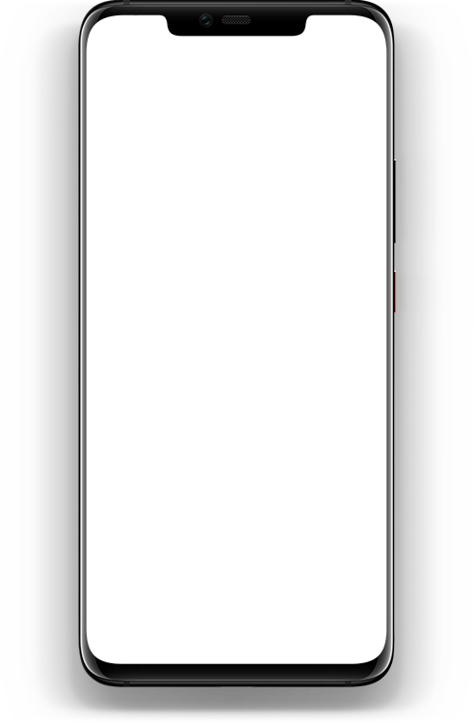
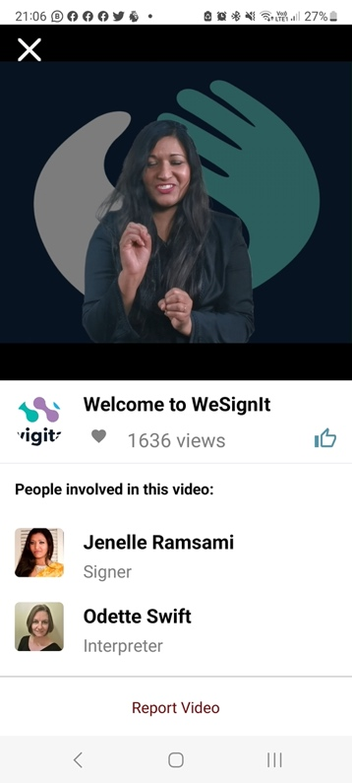
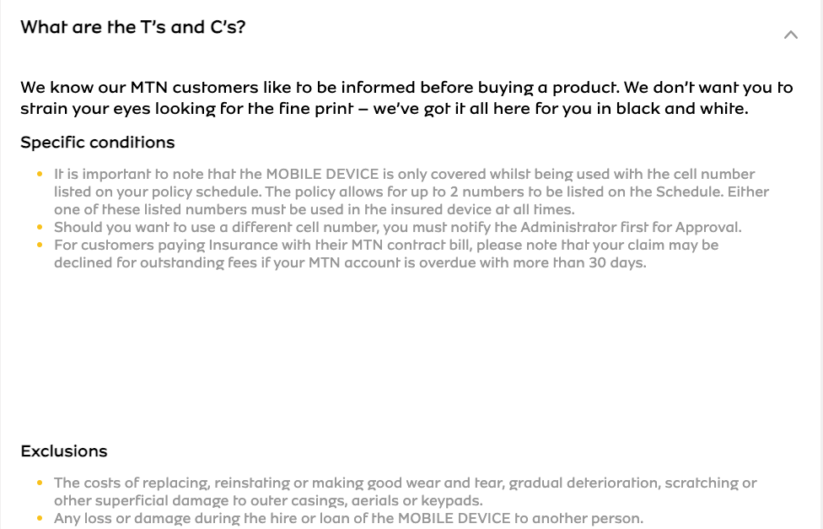
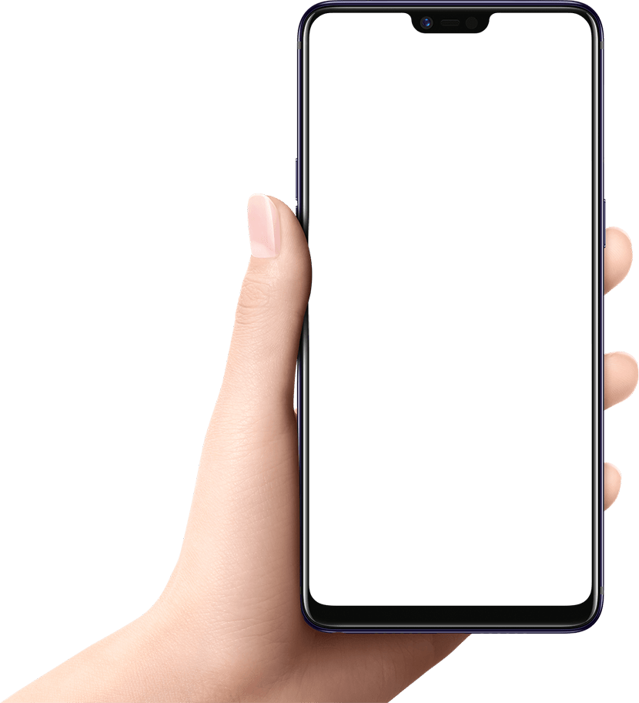
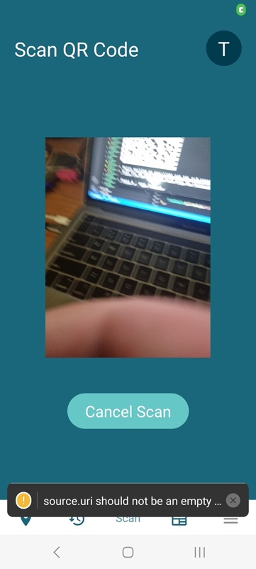
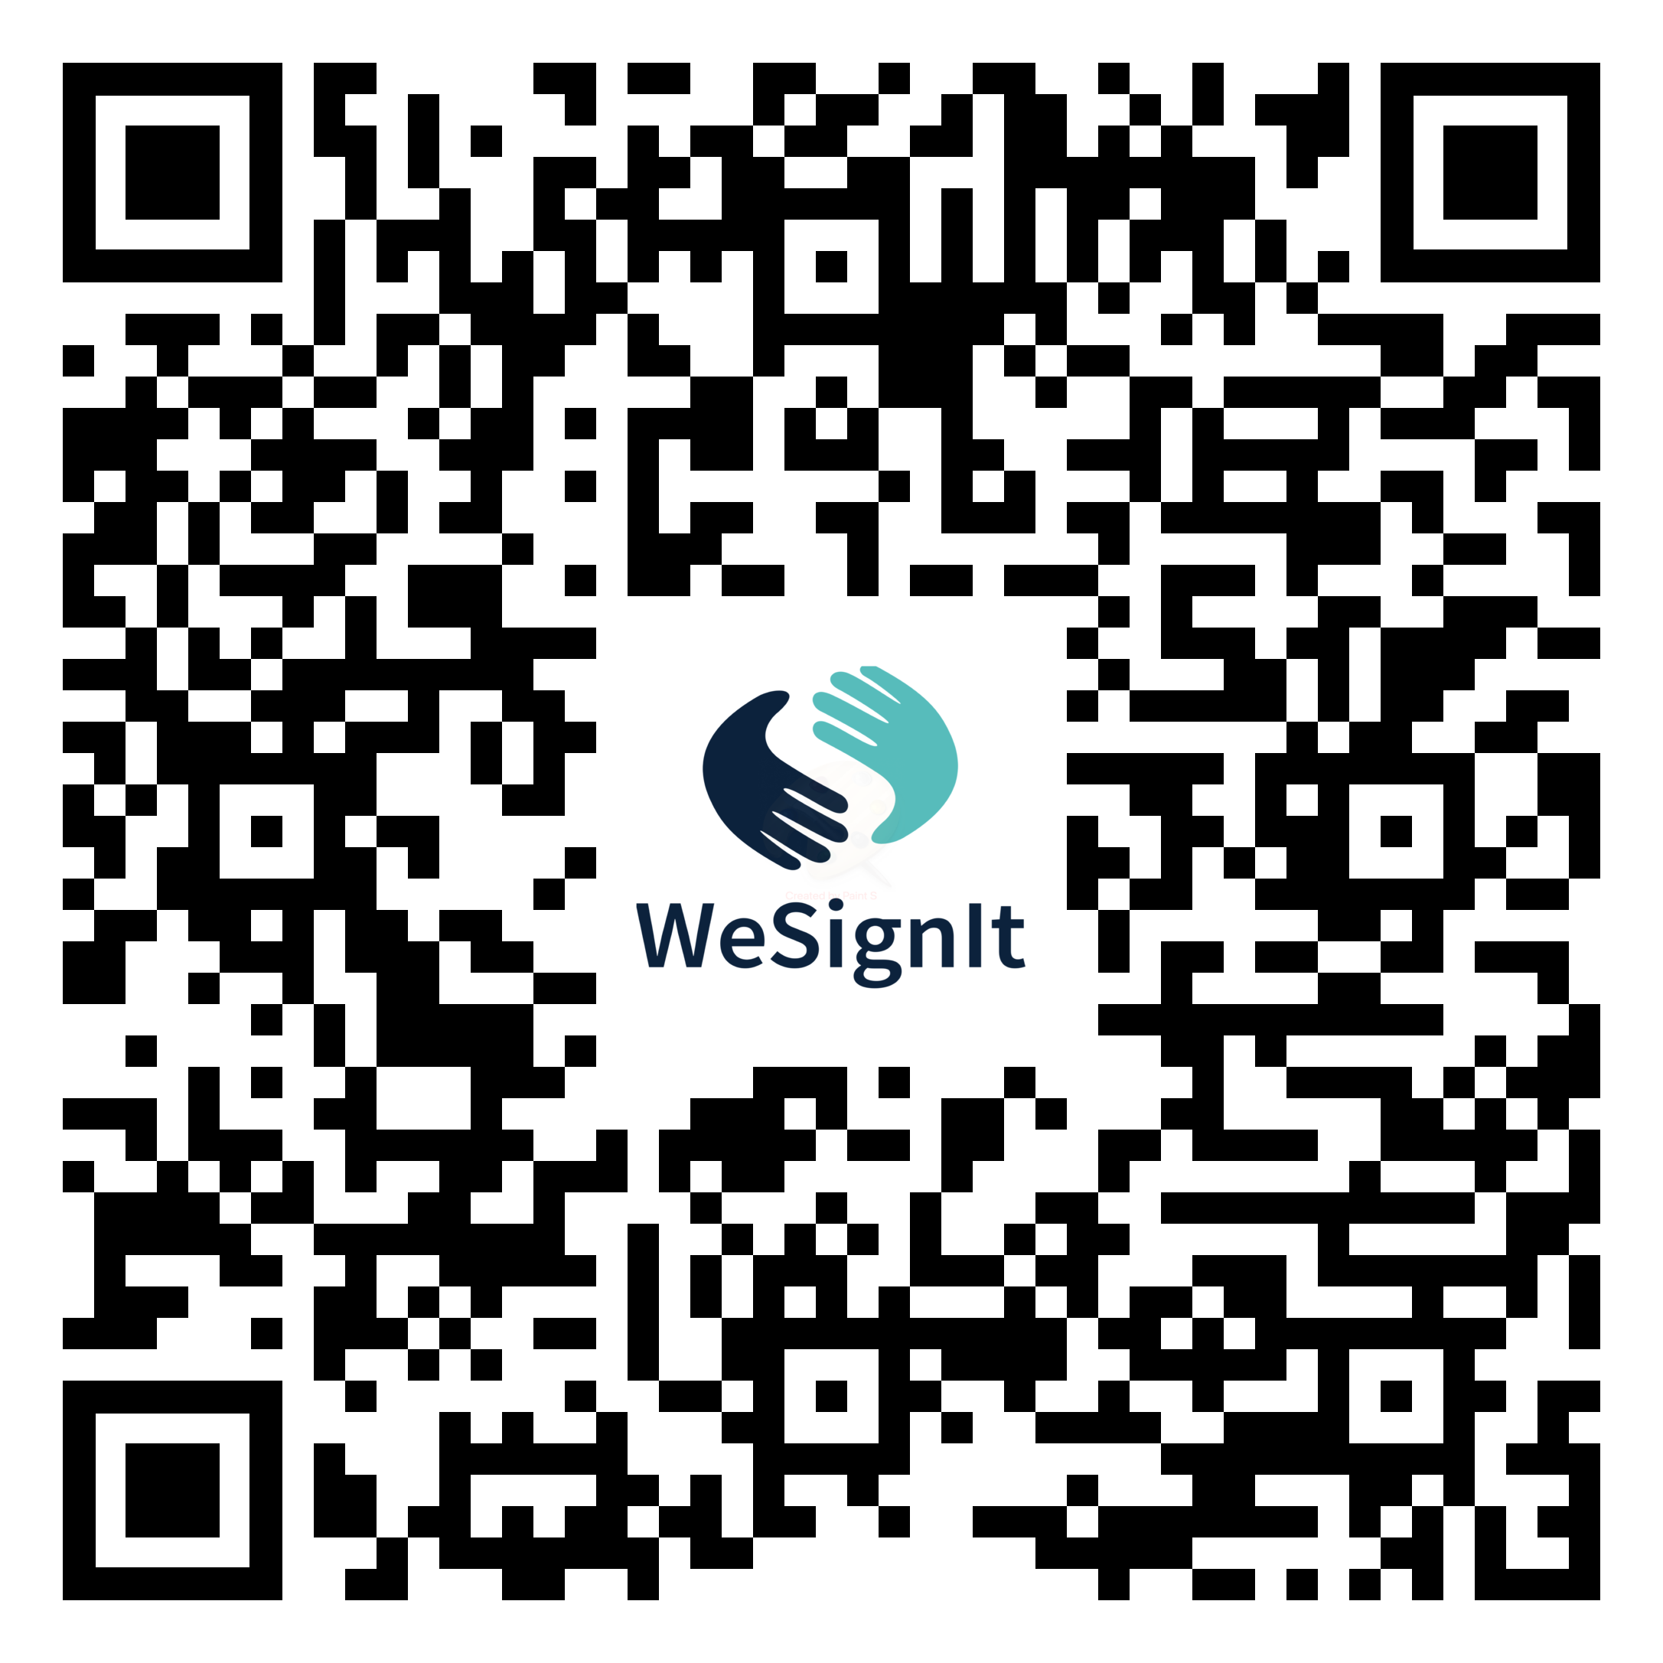
Engaging the Deaf
community in their terms

Slide 3

English: “I want to go to the doctor”
SASL: “Doctor I go”
They are not the same…

Slide 4


The Technology to Address the Gap…
WeSignIt is a translation tool that changes the way Deaf people interact with organisations by translating written, audio and visual content into pre-recorded Sign Language.

Slide 5
How it works…
Users use the app to scan a QR code which accompanies a piece of written content and are then presented with an SASL translation of that content…

Slide 6
A bit more about WeSignIt - Benefits
Creates inclusion for Deaf people
Allows informed decision making
Store user scan history for later reference
Allows access to critical mainstream content
Language Development - glossary feature
  Develop each region’s version of Sign Language with technical and industry terms – Language Development
Job creation (Signers, Interpreters, Video Editors)
Content is endorsed by DeafSA
No other service like this exists (similar attempts in Austria, but not the same user journey)
Users polled in our research have 100% expressed an interest in this tool and its user journey
  2023 Tech Demo
  World-first study: Purchasing Power of Deaf South Africans

Slide 7
Show-and-Tell Time!

Slide 8
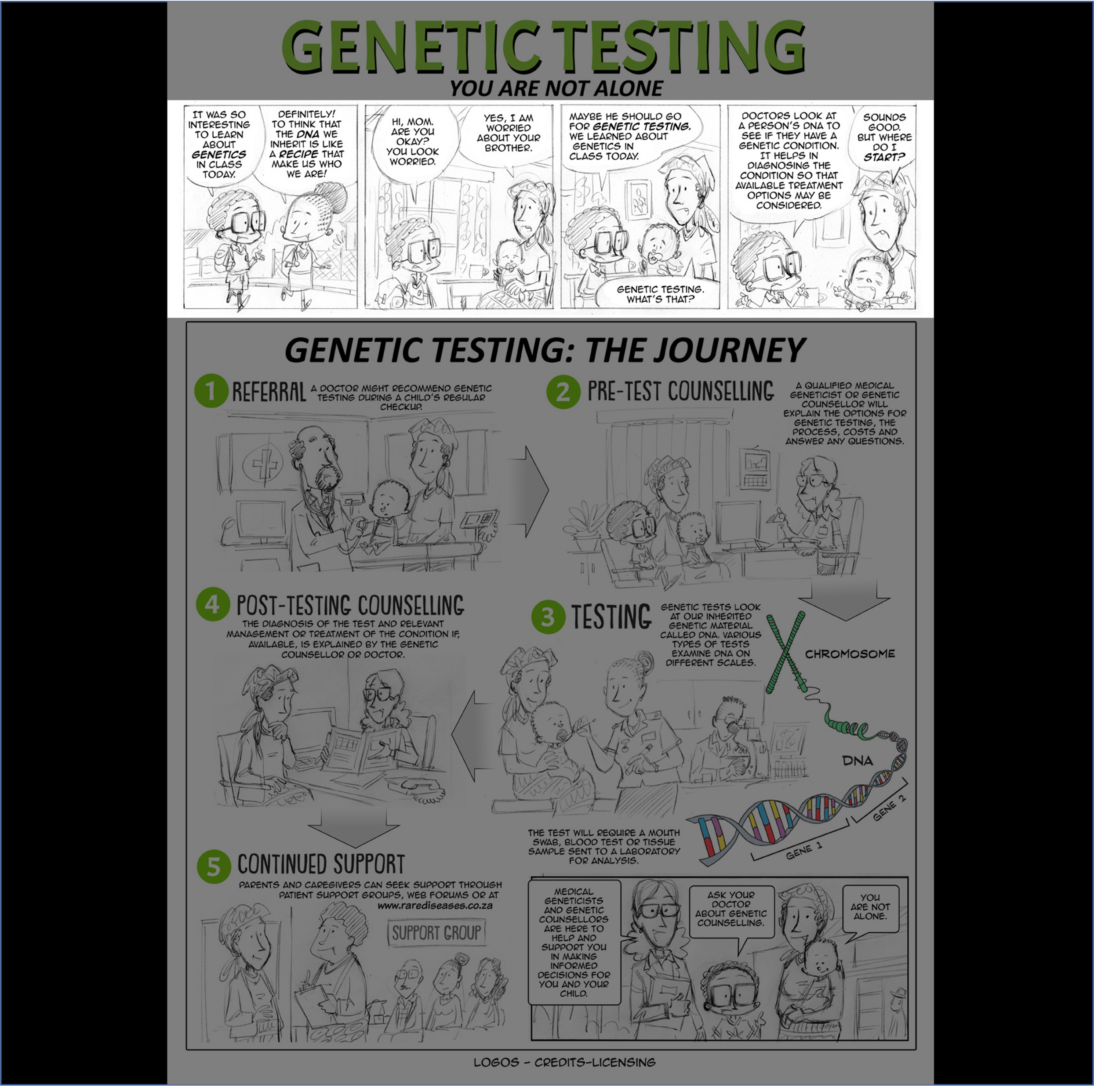
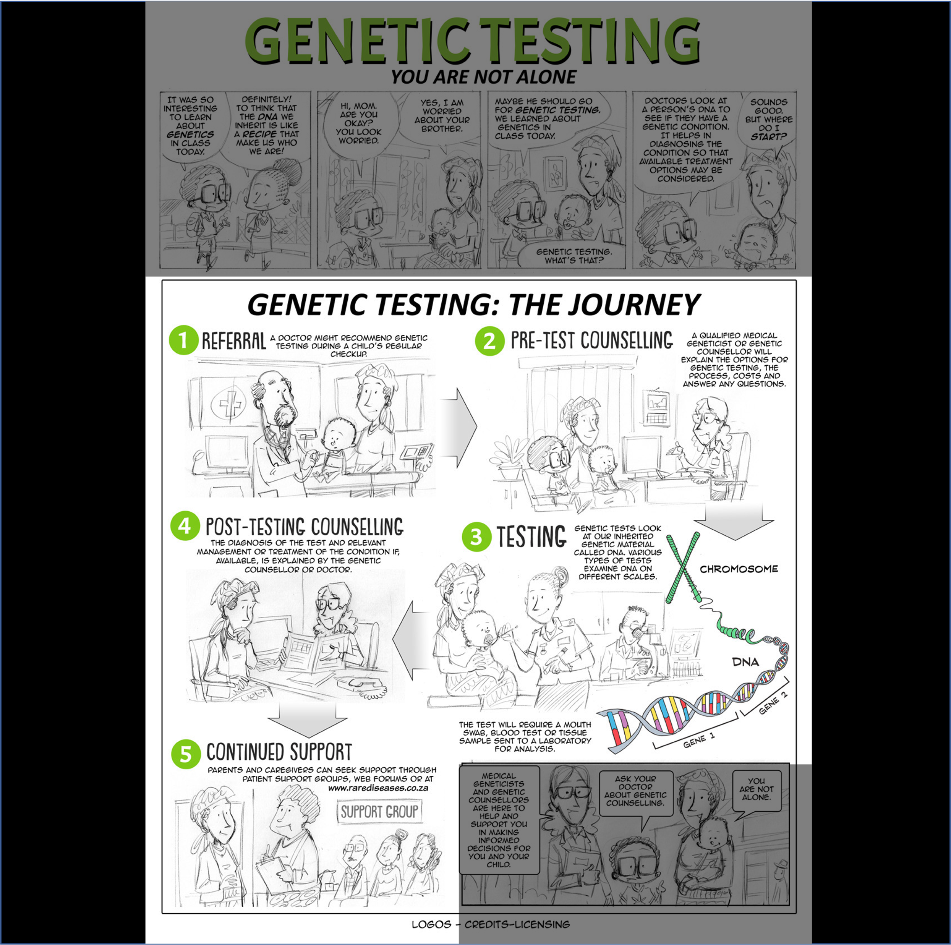
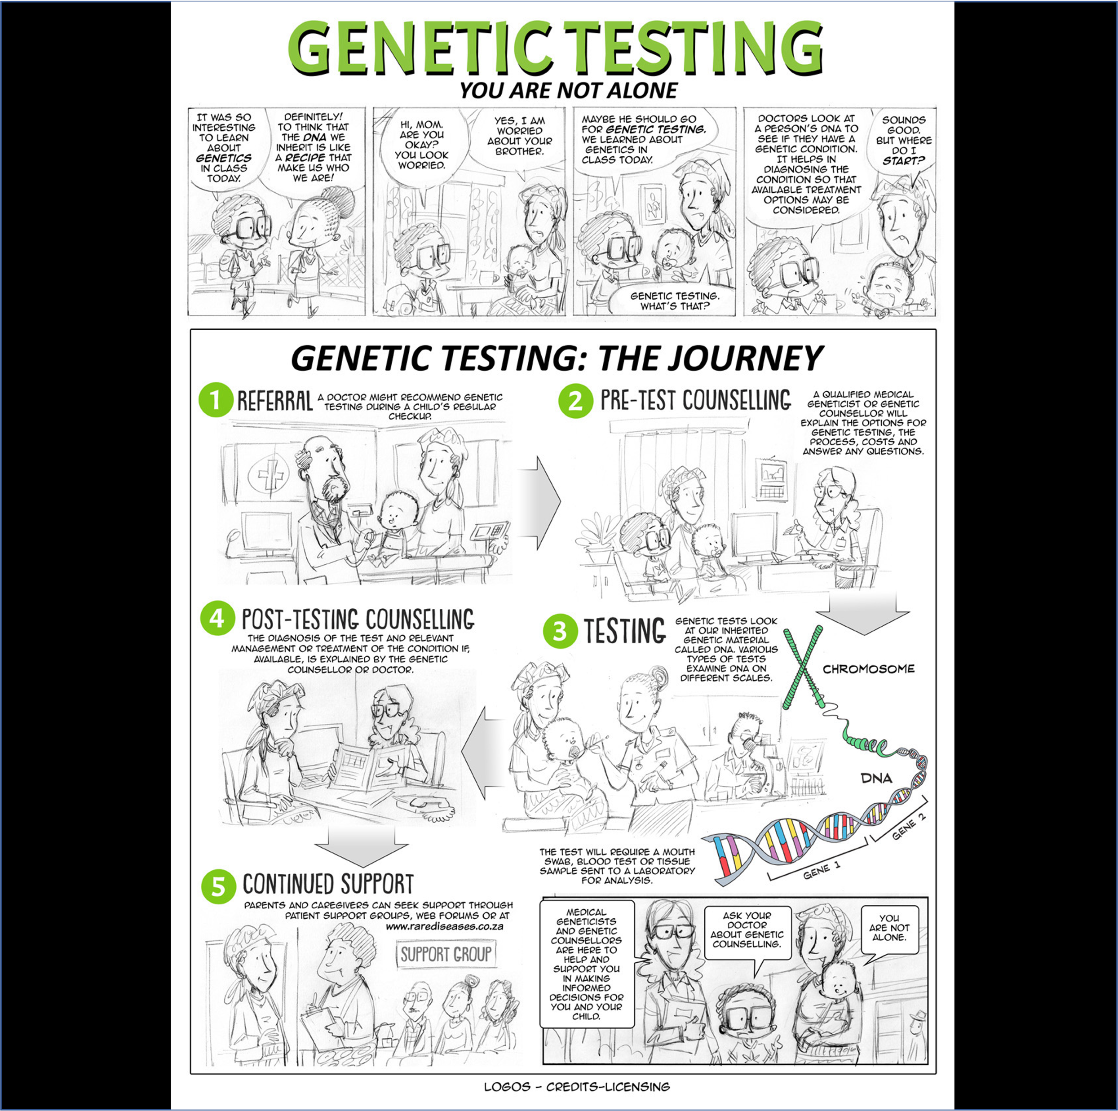
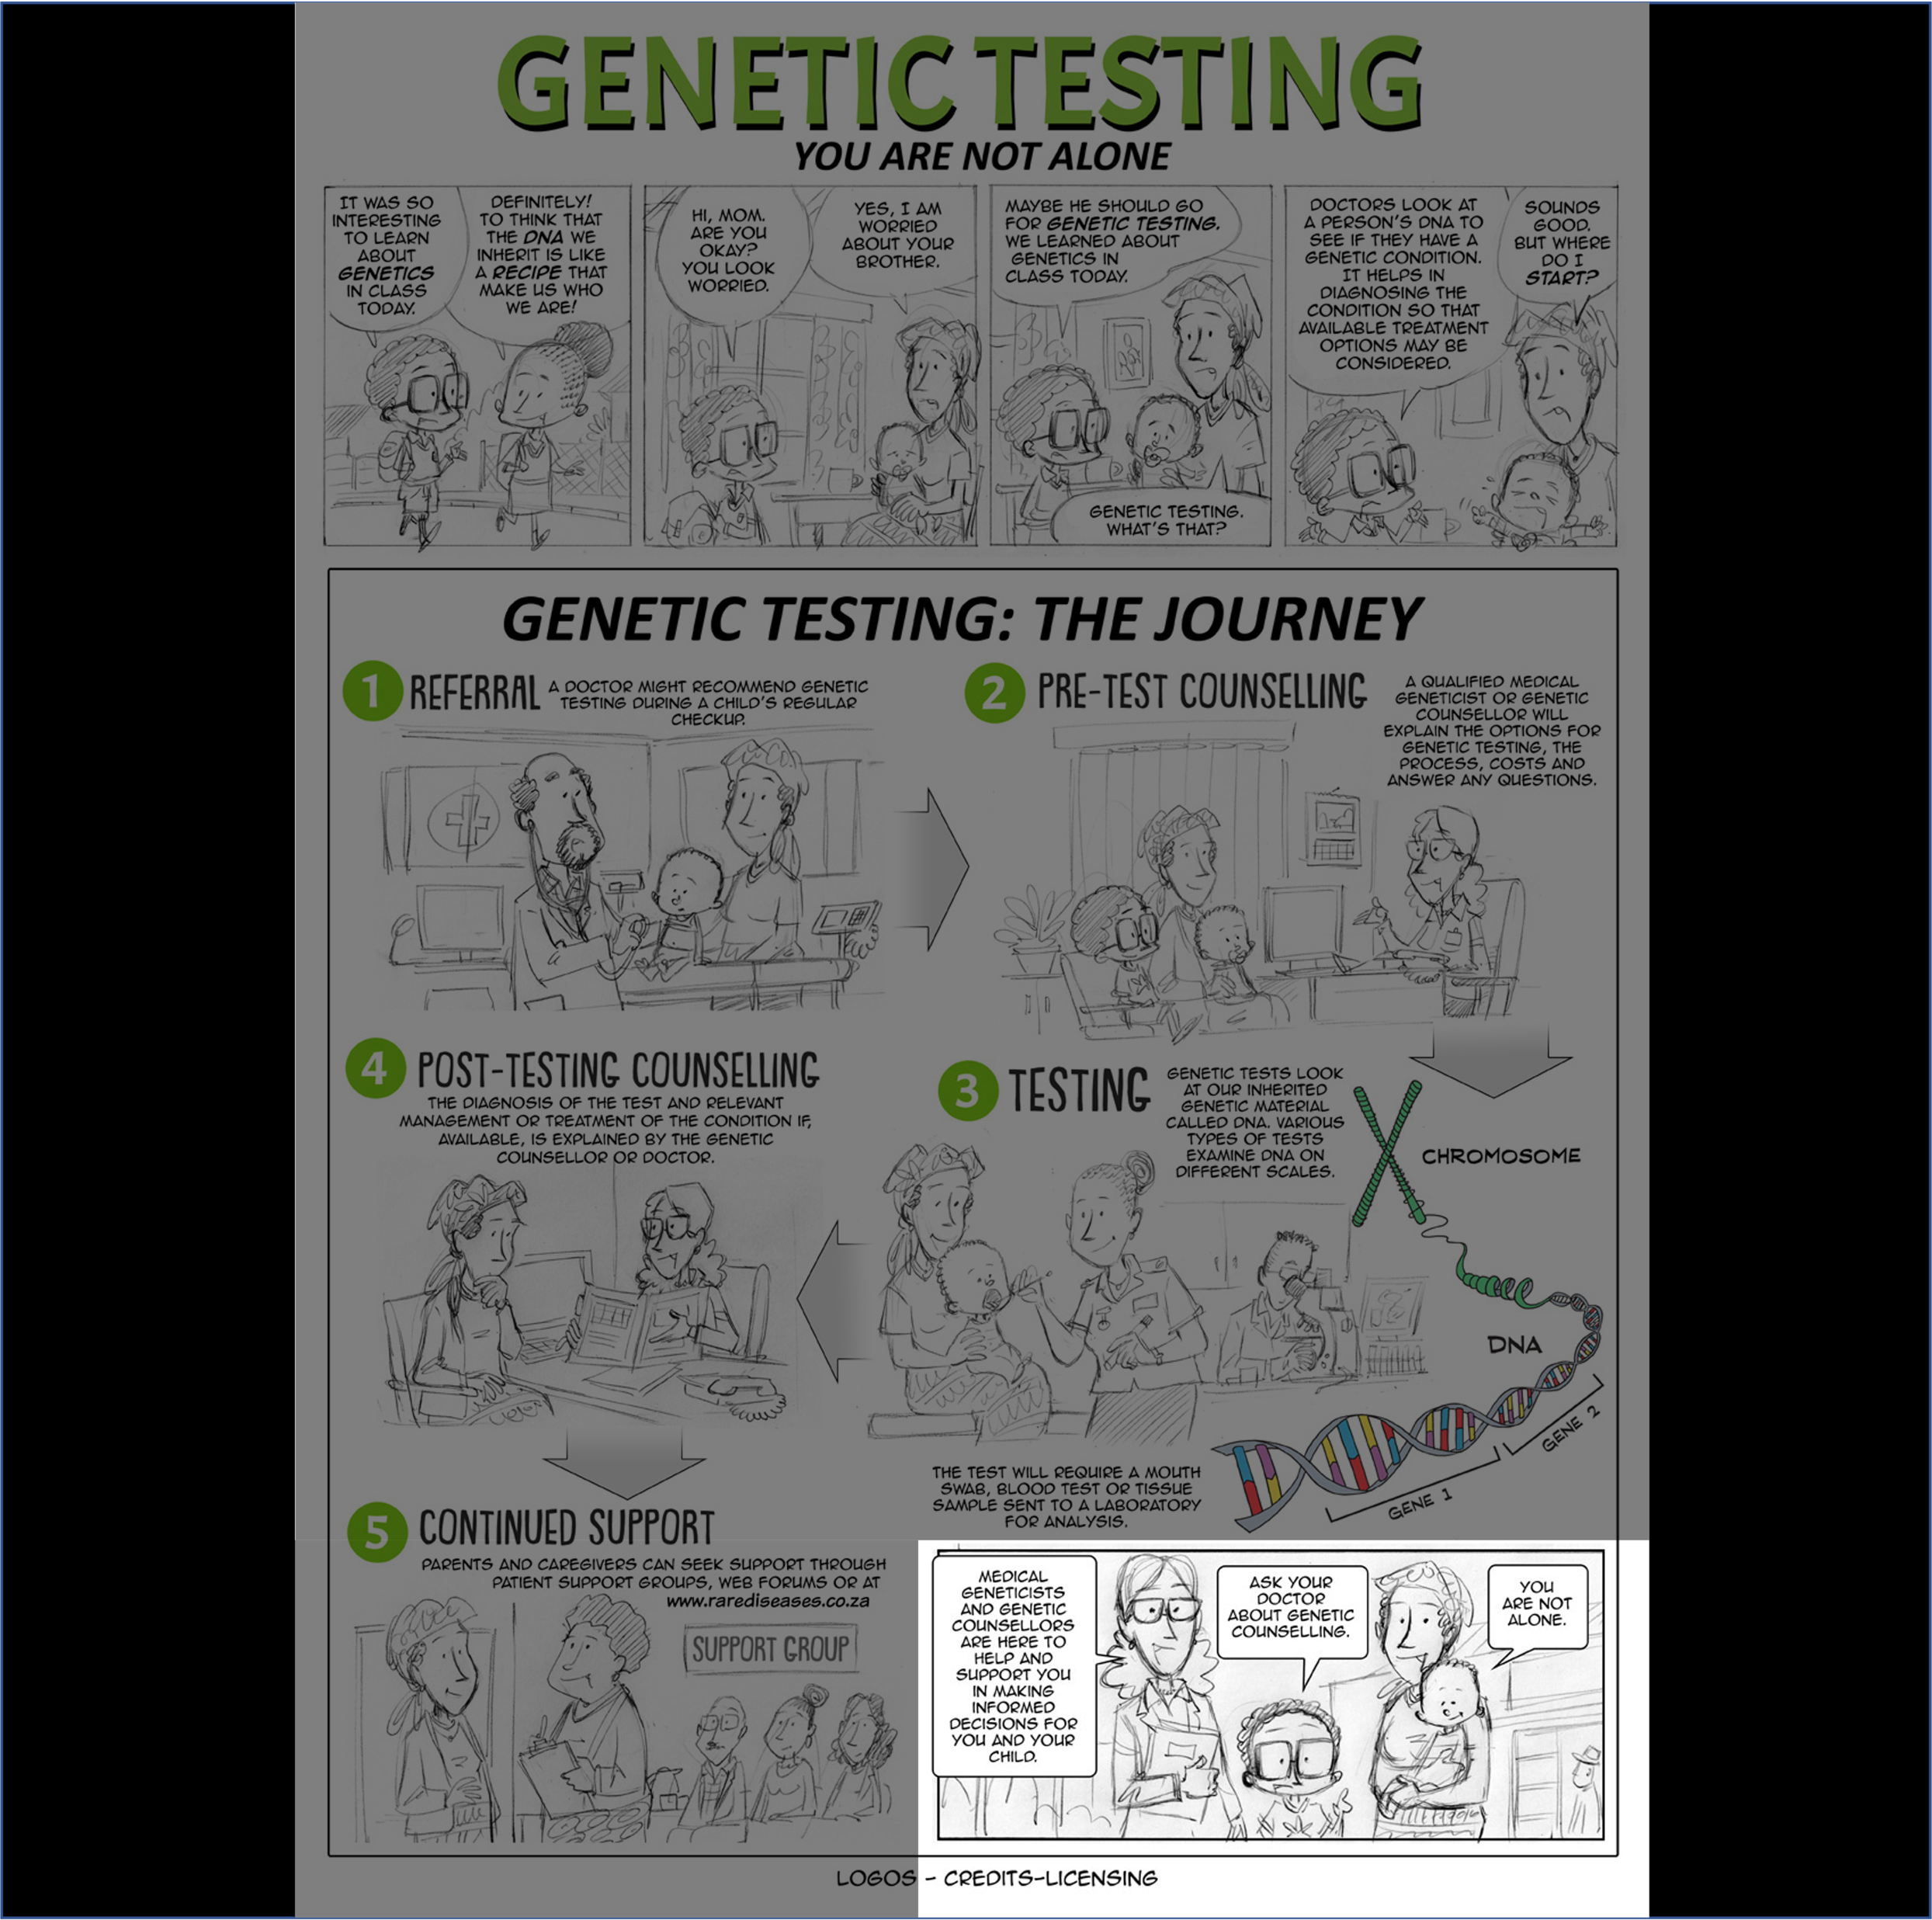
A quick example…

Slide 9

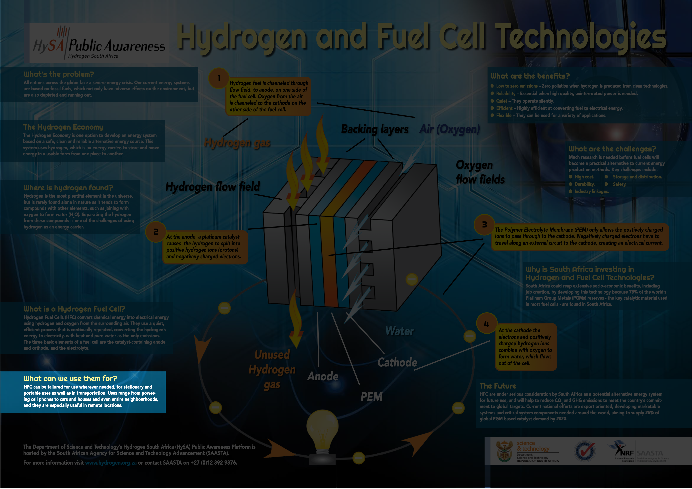
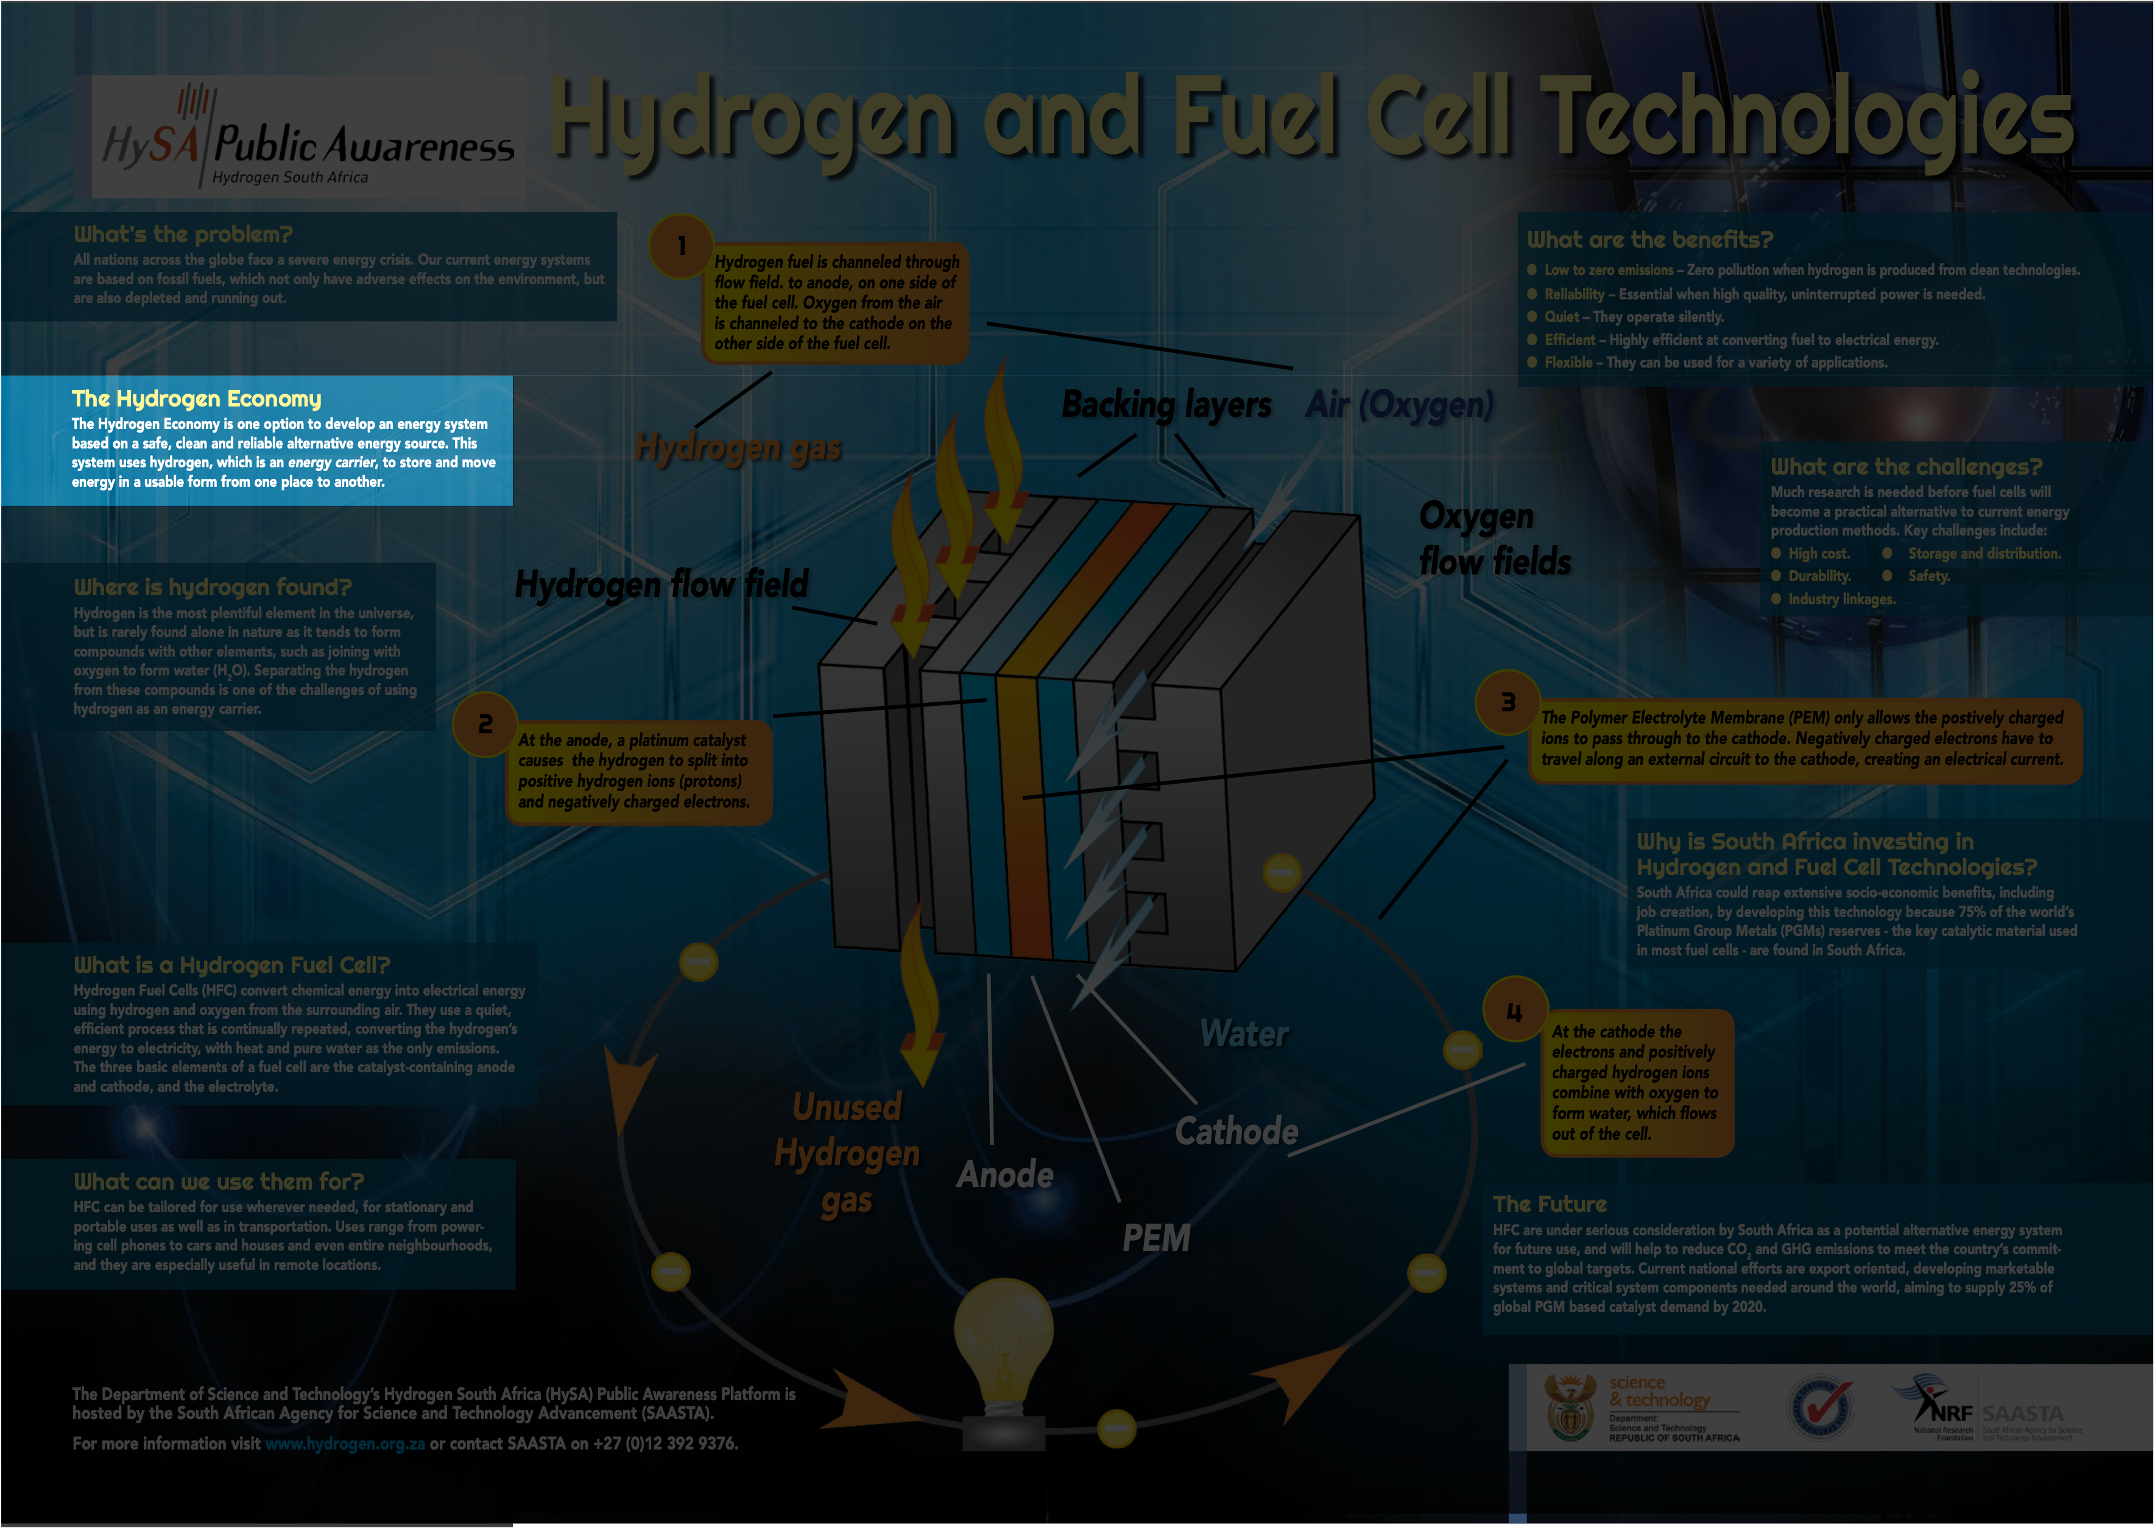
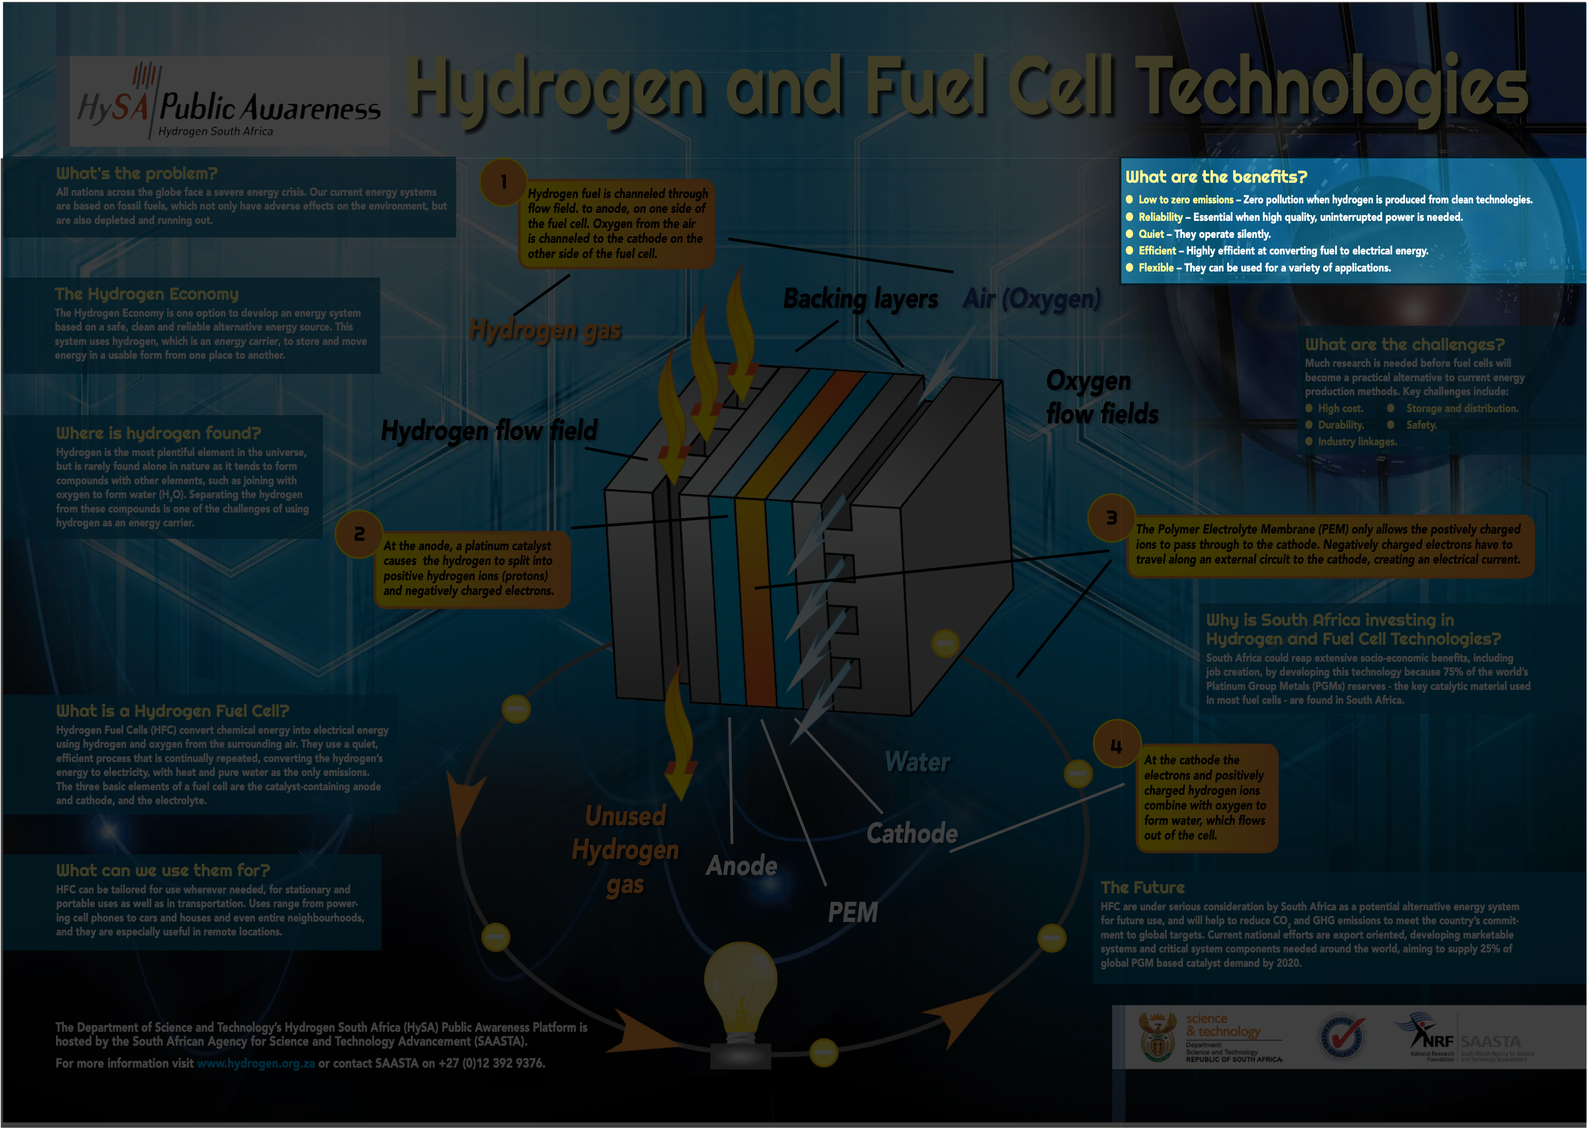
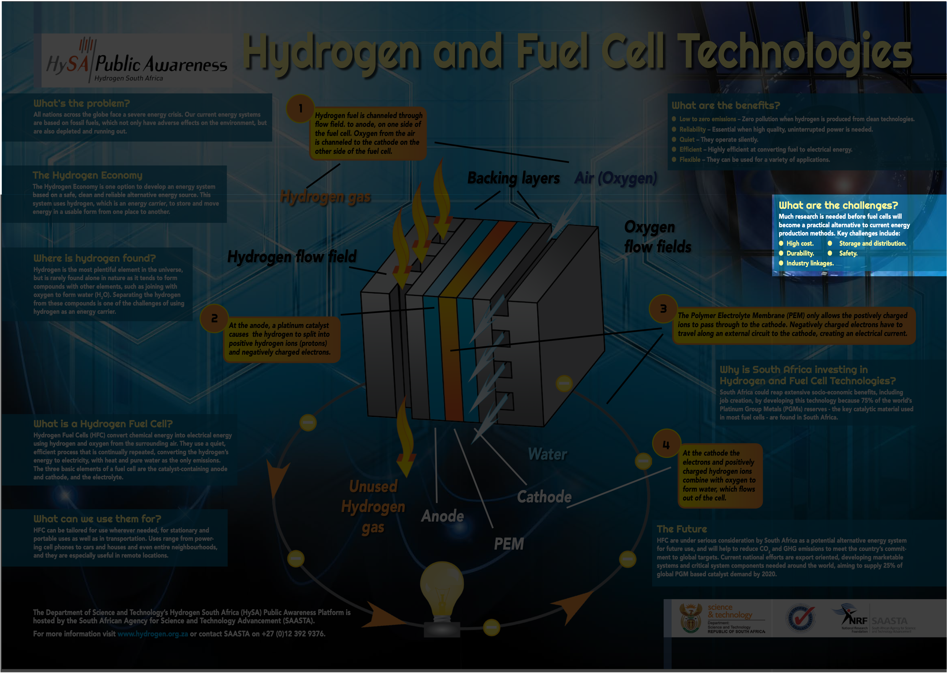
A practical look (1:many)

Slide 10

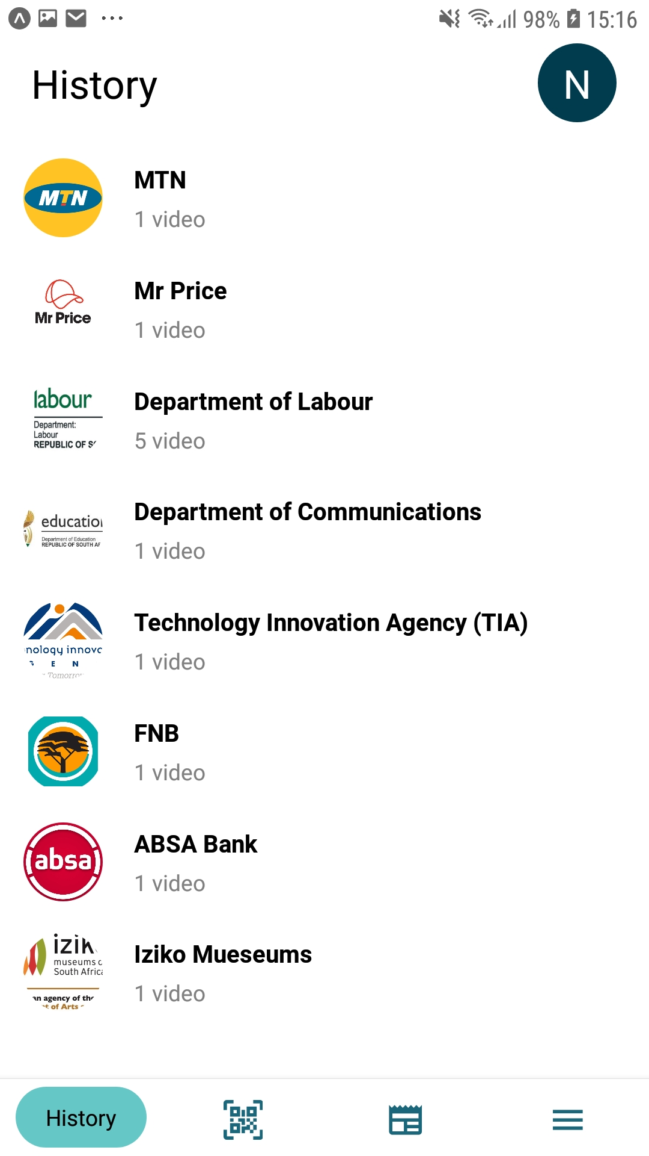
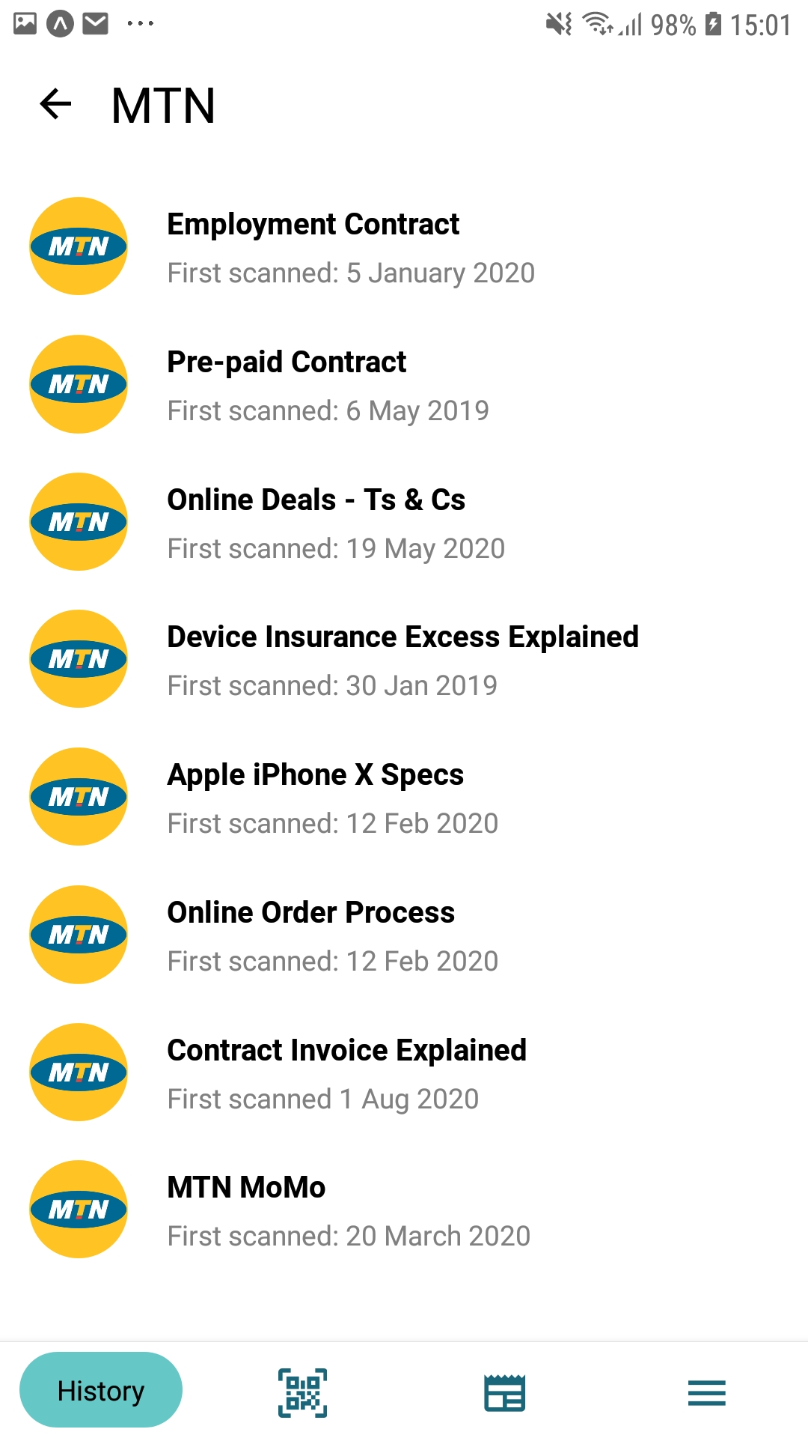
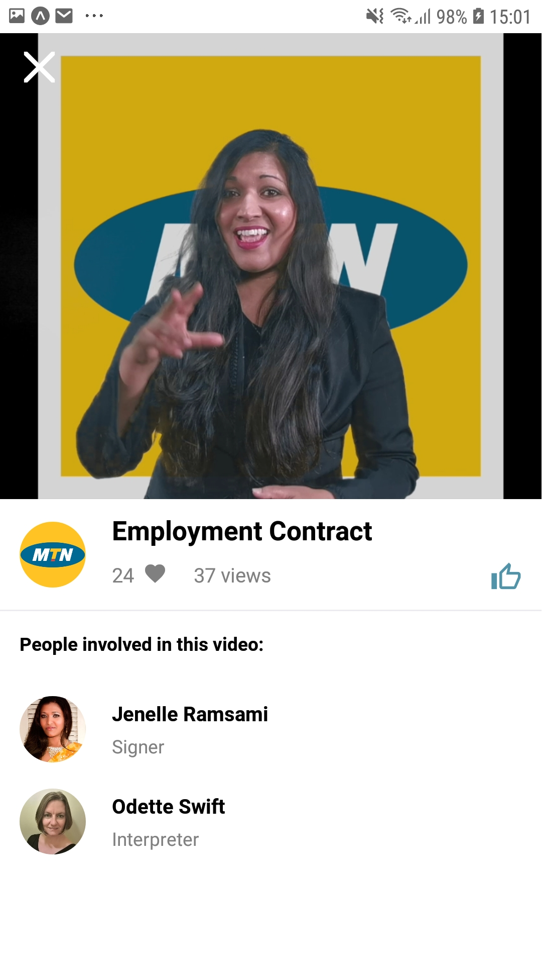
The benefit of future reference
Users can view their scanned history for later reference, being able to access the terms and conditions or other content that they previously viewed.

Slide 11
To our valued guests and delegates:

Slide 12
Why government as a first-adopter?
Government will become completely inclusive and accessible
Seen to be taking charge of the inclusivity drive
SASL = 12th Official Language – put money where mouth is – reach the Deaf in their terms
Expand audience reach – access and engage audiences previously not catered for at such a level
Do the right thing
Gain valuable audience insights
Increase ROI on governmental communication spend

Slide 13
Roadmap – Beyond the Now

Slide 14
Roadmap – FY2025/6
Complete the TADF programme with a market-viability report – August 2025
Engage with government as a strategic target and first-adopter (DoH, DoE, DSTI, GCIS, DoSD, Etc…)
In-App acceptance of Ts & Cs
AI Integration: Near-real-time translations between SASL and English users (Requires funding but will be a world-first!)

Slide 15
Please fire questions at will

Slide 16
THANK
YOU

